Slide 1
MMA 867 Predictive Analytics Logistic Regression
Master of Management Analytics
Jue Wang

Slide 2
What is Classification, and Why do we Need it?
So far, we only considered predicting a quantity (e.g., price of a diamond)
An equally common task is to predict an outcome of an event:
Will a customer default on a loan?
Will a customer click an ad?
Will a Covid-19 patient die?
Will a guy vote for Biden or Trump?
More example?
Predicting the “label” of a sample: classification

Slide 3

Probabilistic Classification
Uncertainty associated with predictions
CIA director Leon Panetta “I am about to go look the president in the eye and what I’d like to know, no bullshit, is he (Osama bin Laden) there or is he not there?”
The deputy director: “We don’t deal in certainty. We deal in probability. I’d say there’s a sixty percent probability he’s there”
https://www.youtube.com/watch?v=k7R2uVZYebE

Slide 4
Learning Objectives
Module 1: Classification, logistic regression
Logit Model
R Implementation
Module 2: Measuring the accuracy of prediction
Assignment #2: Predicting popularity of music records
Module 3 (optional): Maximum Likelihood Estimation

Slide 5

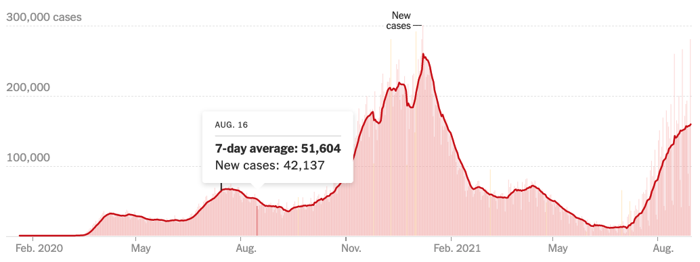
Predicting Who Will Die From COVID-19
ICU bed shortage: an urgent need to effectively triage patients with COVID-19.
Many patients deteriorate rapidly after a period of relatively mild symptoms, emphasizing the need for early risk stratification.

Slide 6
Predicting Who Will Die From COVID-19
Research has identified several clinical features associated with the severity of COVID-19 infection. But a simple scoring system specific to COVID-19 is lacking.
We are asked to create a predictive model and a risk score system to predict the mortality risk of individual patient.
BNP hormone is made by heart and shows how well heart is working
If we know BNP, can we predict COVID death?

Slide 7
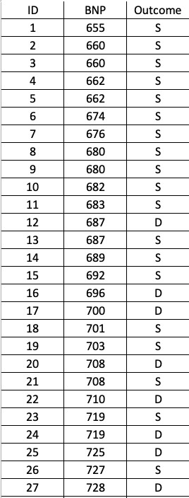
Predicting Events: "Y" is Categorical
Data: BNP Test result with the final outcome: Death (D) versus Survive (S)

Slide 8
Linear Regression?
Step one: Transform S/D into a dummy variable (0,1)
Step two: Run a linear regression model
D
S

Slide 9
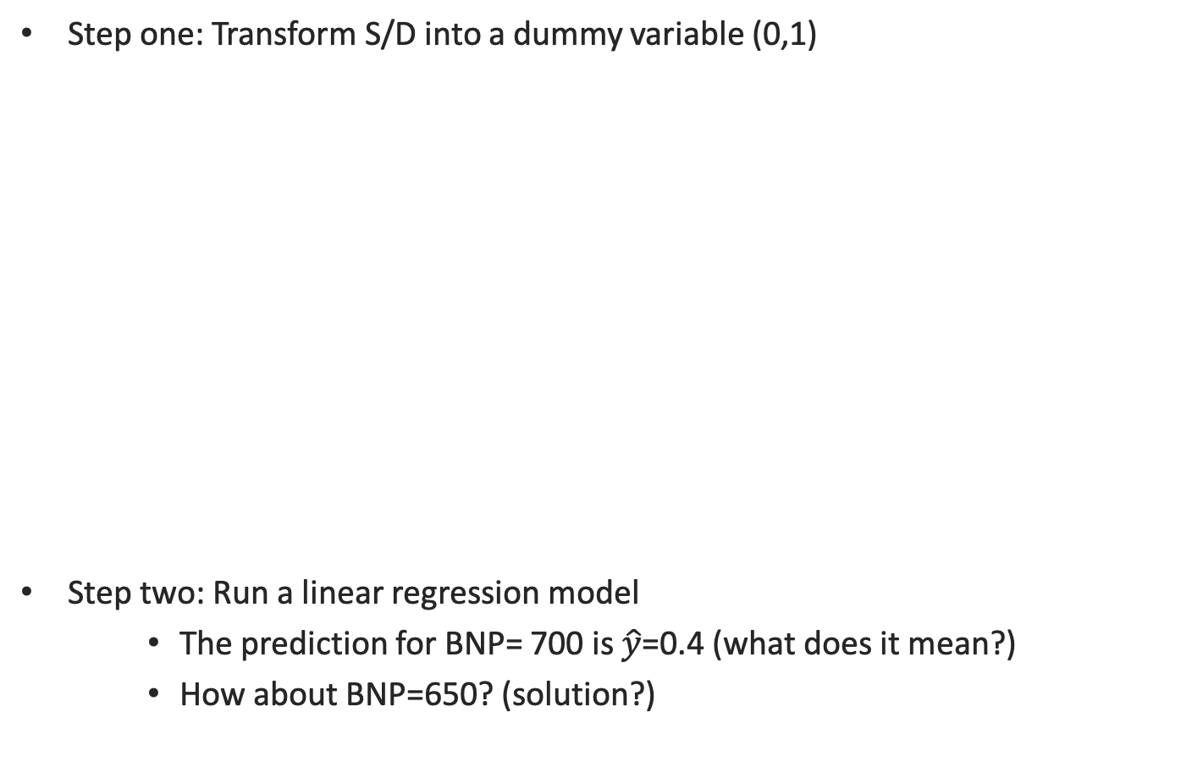
Linear Regression?
Step one: Transform S/D into a dummy variable (0,1)
Step two: Run a linear regression model
The prediction for BNP= 700 is $\hat{y}$=0.4 (what does it mean?)
How about BNP=650? (solution?)
D
S

Slide 10
Linear Regression?
Step one: Transform S/D into a dummy variable (0,1)
Step two: Run a logistic regression model
Use an “S”-shaped curve (logit model) instead of a straight line

Slide 11
Logistic Regression
It is natural to interpret the "Y" variable as the probability of death.
We predict the probability of death, not the death itself.
Linear model is not suitable for predicting probabilities, because it cannot guarantee “0<the prediction <1”
Logistic regression is a simple yet powerful model for predicting probability.
There are other models too (e.g., Probit), but logit model often works the best.
Probability of “y=1”

Slide 12

Interpreting the Logit Model
What does the intercept $β_{0}$ mean?
What does the slope $β_{1}$mean?

Slide 13
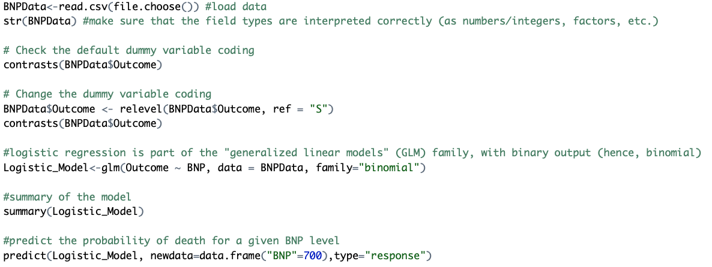
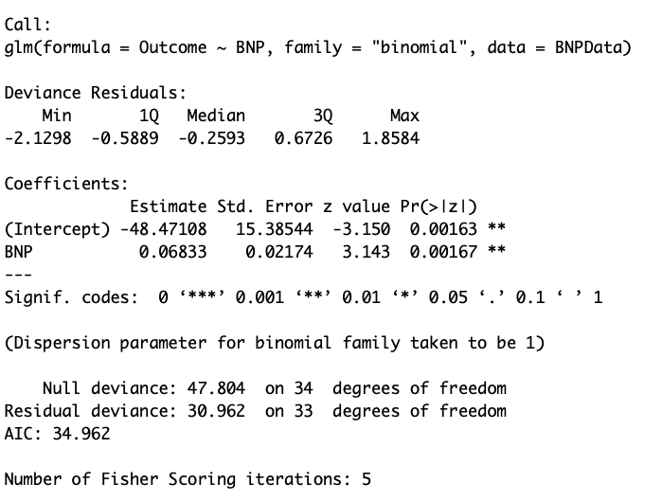
Logistic Regression in R

Slide 14
Module 2: Measuring the accuracy of prediction
Predicting continuous quantities
Mean Squared Error (MSE)
Predicting categorical quantities
Confusion matrix
ROC (receiver operating characteristic) curve and AUC (area under curve)

Slide 15
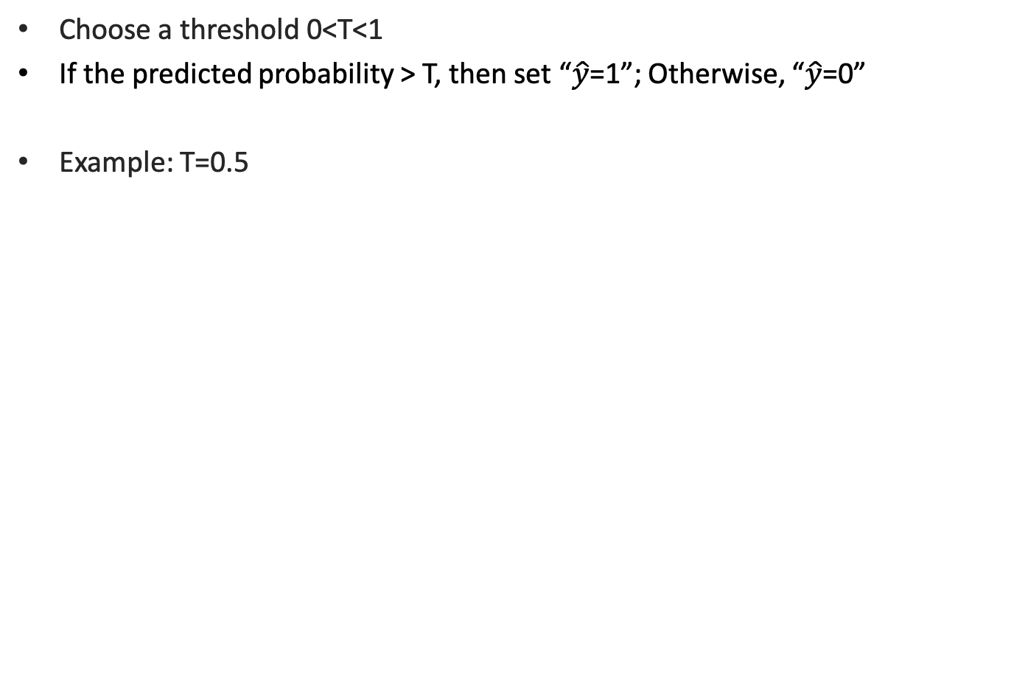
Threshold rule: Convert Predicted Prob. back to 0/1
Choose a threshold 0<T<1
If the predicted probability > T, then set “$\hat{y}$=1”; Otherwise, “$\hat{y}$=0”
Example: T=0.5
0
1
1
1
1
1
1
Death
1
1
Survive
0
0
0
0
0

Slide 16
Threshold rule: Convert Predicted Prob. back to 0/1
If we choose T=0.5
0
1
1
1
1
1
1
1
1
0
0
0
0
0
 | Actually died | Actually survived
Predicted death | True Positive 6 | False Positive 2
Predicted survival | False Negative 1 | True Negative 5
Confusion Matrix (T=0.5)
Accuracy rate (T=0.5)
= (6+5)/(6+2+1+5)
= 11/14=78.6%
Misclassification rate= 1- accuracy rate
What is the limitation of accuracy rate?

Slide 17
Sensitivity/ Specificity
Confusion Matrix (T=0.5)
 | Actually died | Actually survived
Predicted death | True Positive 6 | False Positive 2
Predicted survival | False Negative 1 | True Negative 5
Sensitivity= True Positive / Actual Positive =6/(6+1)=85.7%
Specificity= True Negative / Actual Negative =5/(5+2)=71.4%

Slide 18
ROC Curve
ROC = "receiver operating characteristic”
Generated by varying the threshold T from 0 to 1
T=0
T=0.5
T=1

Slide 19
AUC (Area Under Curve)
AUC | Quality of Prediction
0.50 | Random
0.50-0.60 | Fail
0.60-0.70 | Poor
0.70-0.80 | Fair
0.80-0.90 | Good
0.90-1 | Excellent
*context specific
(driverless car versus
fin. instrument)

Slide 20
Module 3: Coefficient Estimation

Slide 21
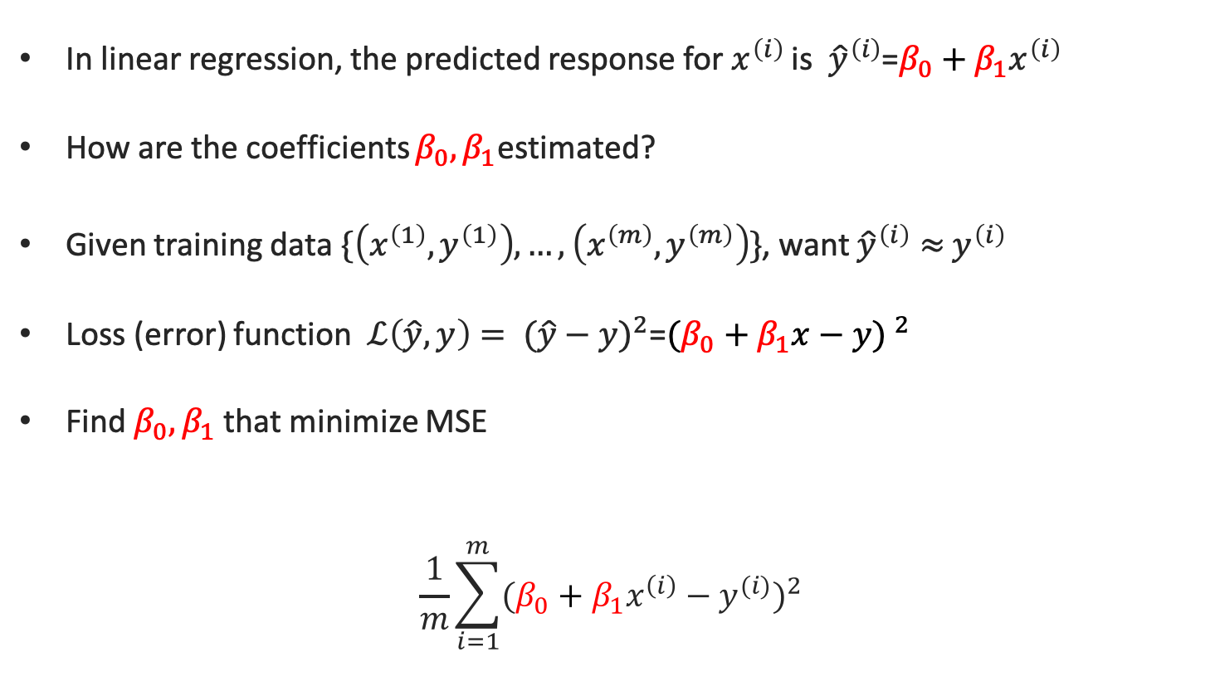
Least Square Estimation for Linear Regression
In linear regression, the predicted response for $x^{\left(i\right)}$ is ${\hat{y}}^{\left(i\right)}$=$β_{0}+β_{1}x^{\left(i\right)}$
How are the coefficients $β_{0},β_{1}$estimated?
Given training data $\{\left(x^{\left(1\right)},y^{\left(1\right)}\right),…,\left(x^{\left(m\right)},y^{\left(m\right)}\right)\}$, want ${\hat{y}}^{\left(i\right)}≈$ $y^{\left(i\right)}$
Loss (error) function $ℒ\left(\hat{y},y\right)= {(\hat{y}−y)}^{2}$=${(β_{0}+β_{1}x−y) }^{2}$
Find $β_{0},β_{1}$ that minimize MSE
$$\frac{1}{m}\sum_{i=1}^{m}{{(β_{0}+β_{1}x^{\left(i\right)}−y^{(i)})}^{2}}$$

Slide 22
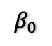
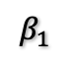
Parameter Estimation = Minimizing Loss Function
Loss Function
$$β_{0}$$
$$β_{1}$$

Slide 23
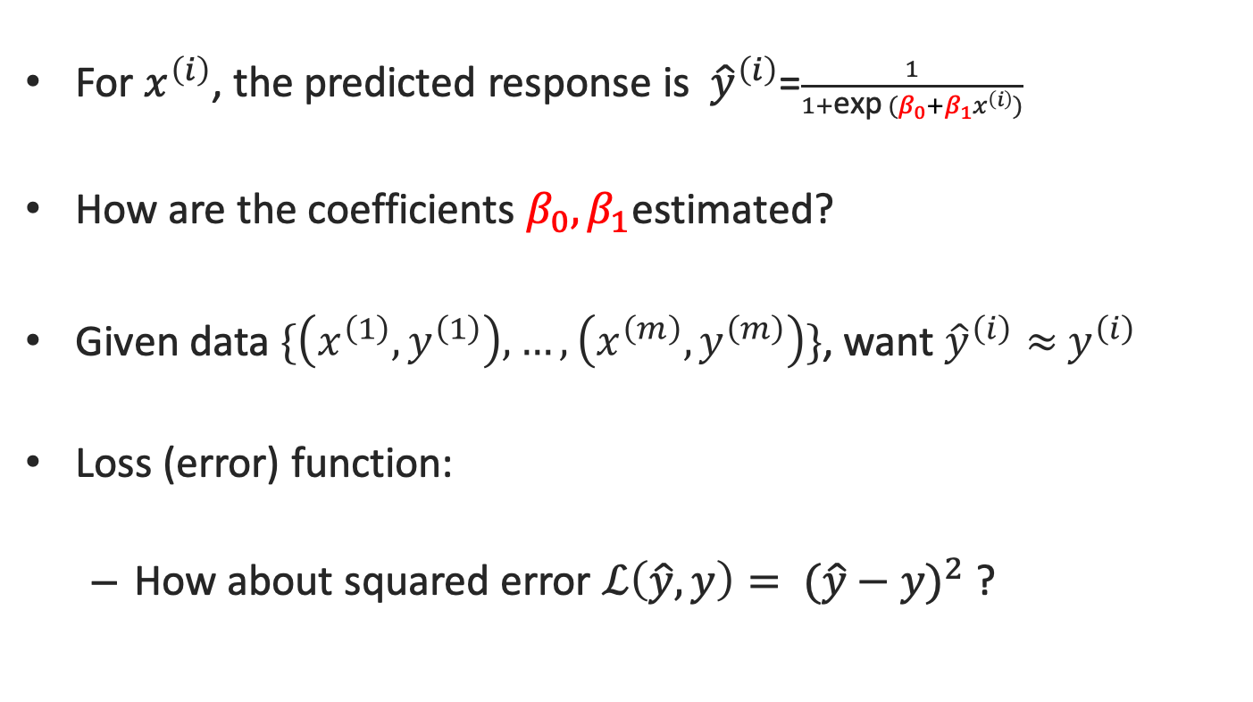
Loss Function for Logistic Regression
For $x^{\left(i\right)}$, the predicted response is ${\hat{y}}^{\left(i\right)}$=$\frac{1}{1+\text{exp} (β_{0}+β_{1}x^{\left(i\right)})}$
How are the coefficients $β_{0},β_{1}$estimated?
Given data $\{\left(x^{\left(1\right)},y^{\left(1\right)}\right),…,\left(x^{\left(m\right)},y^{\left(m\right)}\right)\}$, want ${\hat{y}}^{\left(i\right)}≈$ $y^{\left(i\right)}$
Loss (error) function:
How about squared error $ℒ\left(\hat{y},y\right)= {(\hat{y}−y)}^{2}$ ?

Slide 24
Loss Function: $ℒ\left(\hat{y},y\right)= {(\hat{y}−y)}^{2}$
Loss Function
$$β_{0}$$
$$β_{1}$$

Slide 25
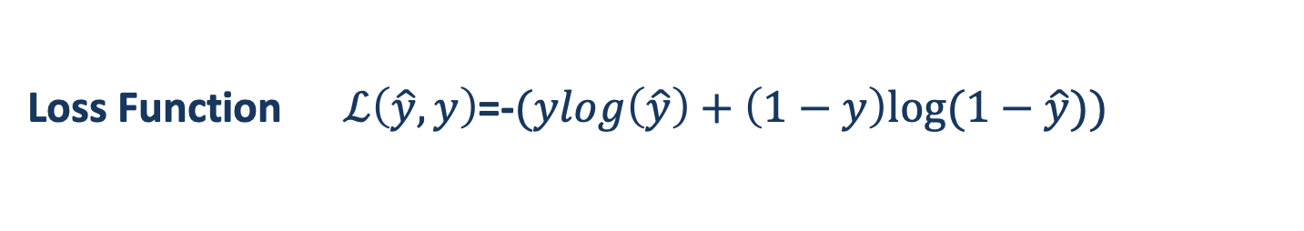
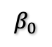
Loss Function $ℒ\left(\hat{y},y\right)$=-$(ylog\left(\hat{y}\right)+\left(1−y\right)log⁡(1−\hat{y}))$
Loss Function
$$β_{0}$$
$$β_{1}$$

Slide 26
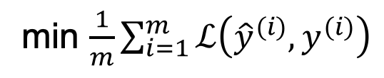
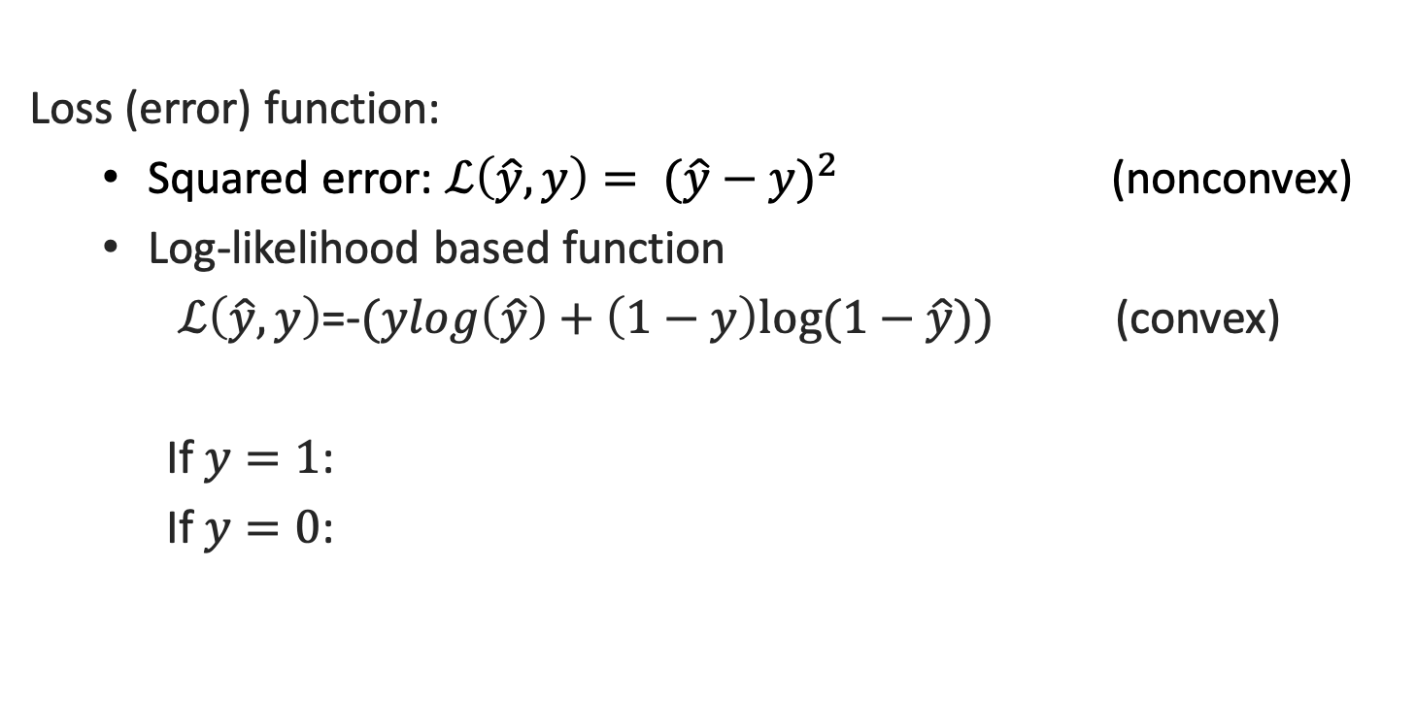
Loss Function for Logistic Regression
Loss (error) function:
Squared error: $ℒ\left(\hat{y},y\right)= {(\hat{y}−y)}^{2}$ (nonconvex)
Log-likelihood based function
$ℒ\left(\hat{y},y\right)$=-$(ylog\left(\hat{y}\right)+\left(1−y\right)log⁡(1−\hat{y}))$ (convex)
If $y=1$:
If $y=0$:
min $\frac{1}{m}\sum_{i=1}^{m}{ℒ\left({\hat{y}}^{(i)},y^{(i)}\right)}$

Slide 27
Gradient Descent Algorithm
Loss Function
$$β_{0}$$
$$β_{1}$$

